Slide 1
Hello,
I am sharing these slides for 2 reasons:
For anyone in a family business to consider some useful ideas about improving your success and satisfaction, personal and business.
For family business advisors and educators to know about some useful ideas and perspectives, in your work with family businesses
In 2023, I am semi-retired, doing some coaching and training but only occasionally working with a family business, and little to no speaking on the subject, so I’m glad to share this for anyone to use freely. If you felt to give credit, thank you.
Ira Bryck

Slide 2
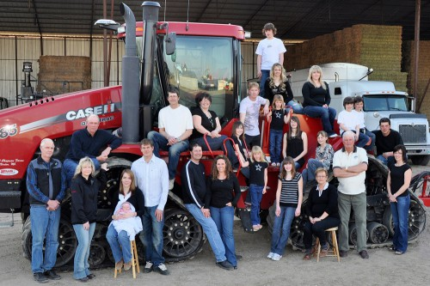
Some Perspectives
to Help You Advise
Family Owned
Companies
Presented by Ira Bryck

Slide 3
Ownership
fo
om
fom
fm
Management
Family
By Renato Tagiuri and John Davis

Slide 4
“Let’s just determine ROI and send me my checks” o
“What’s the problem? Let’s work, get along, prosper, and stop quibbling!” fom
Ownership
“I am SO taking a risk, and want my reward, not to mention a vote” fo
om
“If you don’t add to the bottom line, you shouldn’t own stock” om
fo
fom
fm
Management
Family
“It’s Thanksgiving- let’s stop talking about work” f
“We can’t keep hiring relatives who aren’t up to the task” m
“Forget dividends, we need new machinery, and I need a new car!” fm
ILB

Slide 5
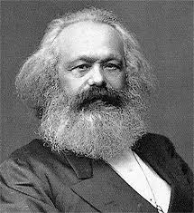
Saying is believing
Only family should rise to the top
I love you equally, so pay you equally
If all else fails, there’s always the family business
You don’t have to be crazy to work here, but it helps
From each according to his ability, to each according to his need
How can you challenge clients to re-think these positions?
From
each according
to his
ability…

Slide 6
Gathering perspectives
Briefly describe (in your opinion) your company’s chances for success and growth in the coming years.
What have been (in your opinion) the most important strengths till now, which have brought the company to its current level of success?
What are (in your opinion) your major strong points (both individually and collectively) that will enable you to handle the challenges your company will face in the coming years?
What are your biggest concerns about the company's current and future chances of continued growth and competent management? What would make you happier, to the point of high job satisfaction? What would make you increasingly discontent, to the point of leaving the company?
What is it that you wish others understood about your views and perspectives, that you have not been able to clearly or effectively communicate?
If you could make 3 changes in your work situation, what would they be, and why? (one about how someone else would change; one about how you would change; one about how conditions [not people] would change)
Developed by Ira Bryck

Slide 7
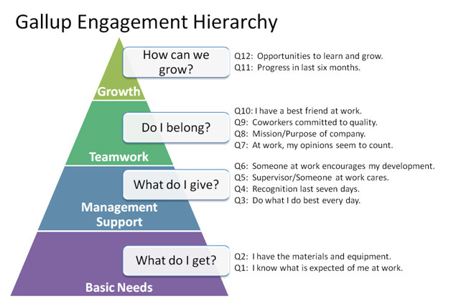

Slide 8
One step at a time towards professionalism
Job descriptions →
High value activities →
Goals and metrics →
Management by Objectives →
Performance evaluations →
Compensation policies →
Budget awareness →
Company of “Owners” →
Attracting/Retaining Best & Brightest
ILB

Slide 9
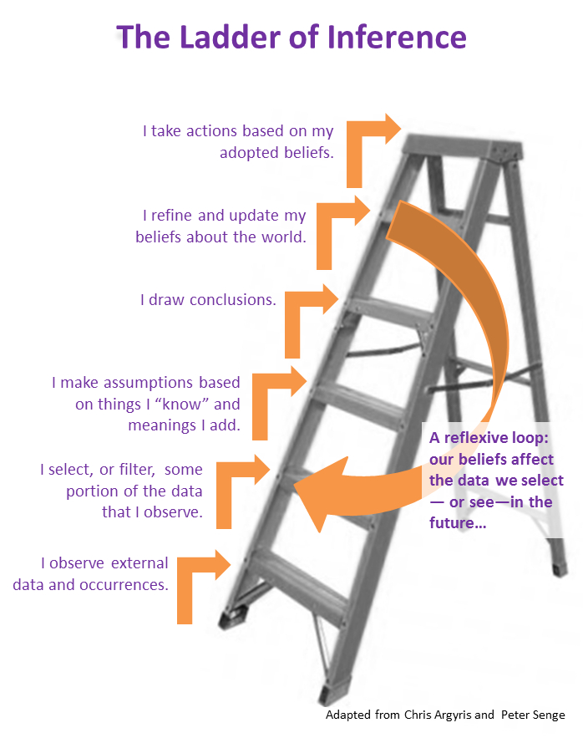

Slide 10
risk tolerant vs risk averse
He wants to bet the farm, I need to sleep at night
If you’re not going forward, you’re going backward
Things are good the way they are, under the radar
The way it’s always worked doesn’t work anymore
What reward is worth the risk?
How to discuss tolerable levels?
What is the effective comfort zone for the group?

Slide 11
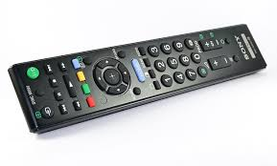
Who’s in charge here?
I can’t hand the reins over to one so untested/ immature/ entitled
I can’t obey someone so bossy
This is my ship, so I’m the captain
This is no business that a woman can run
What qualities are needed?
How can they be objectively measured?
Do different situations require different styles?
How can someone with potential develop skills?

Slide 12
Working with siblings / cousins
Effect of birth order
When they entered the business
Who they married
Cousins are different than siblings
When they each want to retire
Continue the business into the next generation?
Math problems of next gen and stock
Views towards a possible sale
Notes:
Putting cards on table in safety less risky than not doing it
Plan various scenarios, get specific about what needs to happen
Explore options with expert advisors

Slide 13
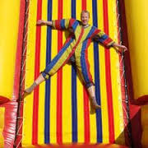
Can we make a plan and stick with it?
I can’t plan if you won’t plan
You promised you wouldn’t invite my siblings in
You said someday this will be mine, but someday never comes
The plan is in my head, right where it belongs
When is a plan not a plan?
What’s stopping you from doing what you said?
What is the unspoken subtext?

Slide 14
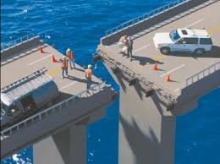
What I’ve tried that hasn’t worked well
Stating the obvious “right answer”
Presenting the “plan” that never gets implemented
Sharing my psychoanalytic perspective
Letting them fight it out
Not letting them fight it out
What has worked, to some degree
Finding points of agreement to build on
Shared values or criteria
Agreeing on goals
Scoring all the options
Agreeing on cost of doing nothing

Slide 15
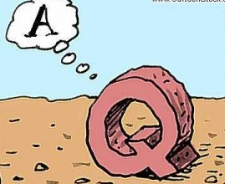
STRATEGIC QUESTIONS
as performance evaluation tool
What’s the risky, innovative next generation of our industry?
How will we measure progress and satisfaction?
What might be our competitor’s biggest fear about us?
How do we get paid for that?
How has change happened here before?
If our business doubled, how would we handle it?
What type of risk tolerance do we have?
What past event makes you think the way you do?
What would it take to do this perfectly & repeatedly?

Slide 16
Code of Conduct
We will/won’t ___ with FB members while not at work We will/won’t ____ when hiring, firing, promoting, FB members We will/won’t ____ when making controversial FB decisions
Best behaviors and attitudes about:
vacation, money, work / life balance,
expressing emotions,
advising/guiding family members,
buying major toys

Slide 17
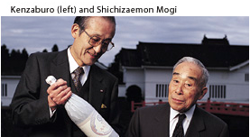
Century old companies
Unstinting respect for elders
Business comes before family
Commitment to manage conflict constructively
Free from competing interests of outside shareholders
I will not be the person responsible for failure of centuries-old enterprise
Ability to change without forsaking basic family values

Slide 18
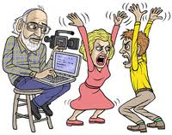
What helps or hurts marriages also applies to business relationships
HURTS
Criticizes character instead of complain about specific behavior
Contempt breeds contempt – insulting and “thing-ifying”
Defensive in response to criticism, escalates conflict
Stonewalling: withdraws when feeling overwhelmed
Negative spiral when corrosive forces outweigh positive
HELPS
Positivity: joke, appreciate, accept, repair, empathize, care
Complaints are specific about behaviors
Avoidant couples can agree to disagree, accept the positive
Volatile couples have heated arguments but can view as equals, be warm and loving, marriage emphasizes and strengthens individuality
Validating couples: mutual respect, compromise, non-coercive, “we” over “me”
5:1 ratio of positive to negative interactions, no matter the style

Slide 19
Some recurring themes:
My husband’s father made promises he won’t keep, is completely in control of the finances and stock
My father was given company by his father; he wants to sell to me, for a high price based on what I made happen here
My siblings own stock but don’t work here; I take all the risk and they demand dividends
We can’t retain talent because there’s no room at the top
The business is safety net for family that can’t do better
It was expected that I’d work here; nobody asked if I wanted to
If I leave the company I could be out of the family
Everyone assumes I only got the job because I’m family

Slide 20
The Diet, Exercise and No Smoking of Family Business – Dr. Joseph Astrachan, Kennesaw College
Family meetings
Strategic planning
Outside board of directors or advisors
Most other “best practices” are not proven to contribute to successful succession (i.e.: 3-5 years of outside experience, family councils and constitutions).
But close family relationships, and ability to have flexible earthquake proofing, does help.

Slide 21
Family council to improve family strategy
FAMILY’S STRATEGIC PLANNING, doesn’t operate biz
FORMULATES FAMILY MISSION STATEMENT how family sees itself and its role in company's future
CREATES POLICIES (or suggests to board) concerning: family participation, compensation, advancement, conduct, sharing financial info, entry & exit strategies, education, substance abuse, distribution of profits and stock
ORGANIZES ESTATE PLANNING for family members
SUPPORTS FAMILY’S CIVIC /PHILANTHROPIC role in society: work together on projects, including charitable giving, venture forum, family foundation
COMMUNICATES family culture, history, tradition, ethics, values
EDUCATES FAMILY about responsibility as owners, how family impacts business
HELPS ELIMINATE SECRET informal, impromptu decisions, stable structure for problem / conflict resolution
ESTABLISH DURING FAMILY RETREAT meet monthly. Begin w/ professional, rotate facilitation by family, developing leadership
INCLUDES ALL FAMILY in & out of business (14 +)

Slide 22
CORPORATE CULTURE discussion questions:
When I die, I want to be remembered for _____
(I demonstrate this by ______)
If my company would cease to exist,
they would like to be known for ________
(they demonstrate this by_______)
My company believes people stay committed because _________
(they demonstrate this belief by _______)
My company believes the big reason
an employee leaves is because _____________
S.O.S. Log Book, Guide to Smooth Sailing, by Sandra Weston

Slide 23
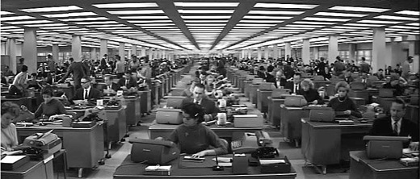
Building corporate culture
All stakeholders, not just stockholders
Reveal key principles, shared beliefs, values
What’s special about business operation & treatment of people
Sample values: ethics, trust, humor & fun, balance, accountability, mutual support, effective communication

Slide 24
Is “the happy family” more luck or skill?
✓ I understand my role in our family and family business.
✓ My role is valued in the family and business.
✓ I feel safe to ask questions regarding issues in our family and business.
✓ We have written communication ground rules, agreed upon by all family members.
✓ When we are discussing family issues everyone’s view point is taken into account.
✓ We are good listeners, even when we disagree with one another.
✓ All family members are treated with respect.
✓ I look forward to going to work each morning and feel passionate about my role.
✓ I see other family members engaged and passionate about our family and business.
✓ As a family we openly and honestly discuss the inevitable conflicts and/or obstacles that stand between us and our goals.
✓ When difficult decisions need to be made we have a system in place to work through issues successfully.
✓ We hold regular family meetings where we work on our family and business issues.
✓ As a family, we do not have scapegoats when difficulties arise.
✓ We have fun together as a family.
✓ Our family genuinely loves and respects one another. We don’t “gang up” on one another.

Slide 25
Whoever you select as next leader
Traits leaders say they want in themselves and their successor:
independent
confident
accomplished
competent
bottom up experience
emotionally intelligent
no special privileges
same metrics as everyone
Affirmative action for family?
Can family see their own objectively?
Notes:
What are the pros and cons of continuing as a family company?
What talent does the business need, that’s not in the family?

Slide 26
Outside board of directors or advisors
Locate icebergs: board tells you what you don’t want to hear
Assesses needs: where is expertise, wisdom, experience lacking
Start w/ advisors, build to directors; or use service providers
Wide range of authority: from questioning assumptions to setting CEO salary
Interested but neutral: outside your box, can help get you unstuck, go beyond plateau, objective about your subjectivities
3-6 meetings per year is optimal (almost half meet 1-2 times per year)
85% of CEOs who put a board in place said was their single best management decision
Lack of CEO / chairman duality increases performance
Two outsiders to each family member improves performance
Outside boards increase financial value (but occupation of board member has no effect)
Board diversity reduces likelihood of strategic change
Outside directors decrease risk of internal fraud
When internal culture is violated the board will have little or no real influence or power

Slide 27
Final test of greatness
Take pride in watching your children succeed.
Develop more of a diplomat role in the business.
Enjoy your second adulthood.
Find meaning as mentor, give something back.
Overcome fear of losing recognition.
Attempt to frankly discuss power, death, money, love.
The final test of greatness in a CEO is how well he chooses a successor,
and whether he can step aside and let his successor run the company.
- Peter Drucker

Slide 28
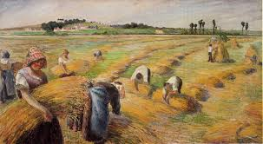
Comments?
Questions?
Thanks!
Please get in touch to discuss any of this more:
Ira Bryck
413 575 5850
ira@irabryck.com

